Slide 1
Rodent Automated Training
Verification and Validation
Ellie Degen, Sara McCutcheon, Zoe Orenstein
Client: Dr. Keith Hengen
March 6, 2019

Slide 2
Changes to Design Specifications
RAT
MOUSE
https://www.amazon.com/Vinyl-Stickers-Rat-Silhouette-Sticker/dp/B0115GNWZW
https://www.pdn.cam.ac.uk/images/homepage/Carousel/best-15-wpid-free-mice-silhouette-vector-image.jpg/image_view_fullscreen
Notes:
Decreasing cage dimensions

Slide 3
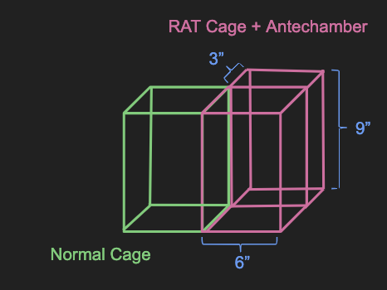
Changes to Design Specifications
6x6x9” living space
3x6x9” antechamber
Transparent wall between cages
Notes:
Decreasing cage dimensions

Slide 4
Changes to Design Specifications
9 PM - 9 AM
WATER DEPRIVATION
10 AM - 9 PM (the next day)
35 HRS UNRESTRICTED WATER
TRAINING
9 AM - 10 AM
Notes:
New water deprivation method and testing schedule
No water access for 12 hours prior to training
Recovery day after training
Rodent will no longer initiate training → removal of beam break
9am training start time
Because of this fixed testing schedule,
Rodent will no longer initiate training
no longer a need for beam break system

Slide 5
Changes to Design Specifications
Old
New
Wall Opening
Screen
Speaker
Water System
Goal-Post Head Fixation
Notes:
Nose poke hole removed
Holes for water spouts
Head fixation 1.5 inches away from water spouts
Speaker closer to water spouts
Antechamber no longer sound proof

Slide 6
Verification Plan
Screens
Solenoid Valve
Capacitive Touch
Sensor
Lights
Speaker
Cage design
Notes:
UPDATED

Slide 7
Screen Verification
Display images at a programmed time
Two screens
Switch images after five minutes
Notes:
two screens connected to arduinos
Two goals
to verify if the screens display the correct images
To verify if we can display the images on a time schedule

Slide 8
Touch Sensor Verification
Measure baseline capacitance
Set a “lick” threshold
Disrupt the spout capacitance with a finger tap
Observe valve opening
Notes:
measure baseline

Slide 9
Valve Verification - Valve Opening
Provide 5V to a driving motor
Solenoid Valve Opens
Observe water pass through valve
Notes:
UPDATED

Slide 10
Valve Verification - Correct Amount of Water
50 repeats: open valve for 0.5 sec, close for 1 sec
Measure total volume of water dispensed
0.5-0.6 mL delivered total?
If yes, repeat test five times
If no, increase/decrease the open time by 0.1 sec
Notes:
to verify that the valve dispenses the correct amount of water
if yes, repeat five times for consistency

Slide 11
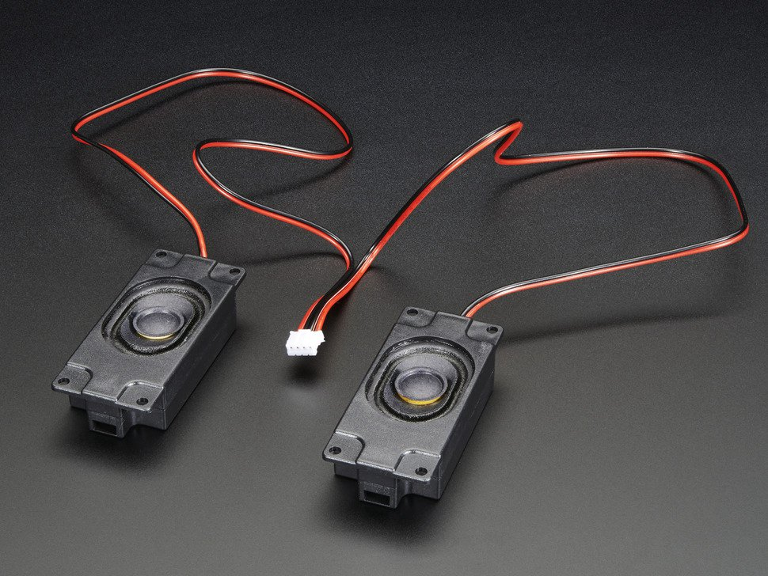
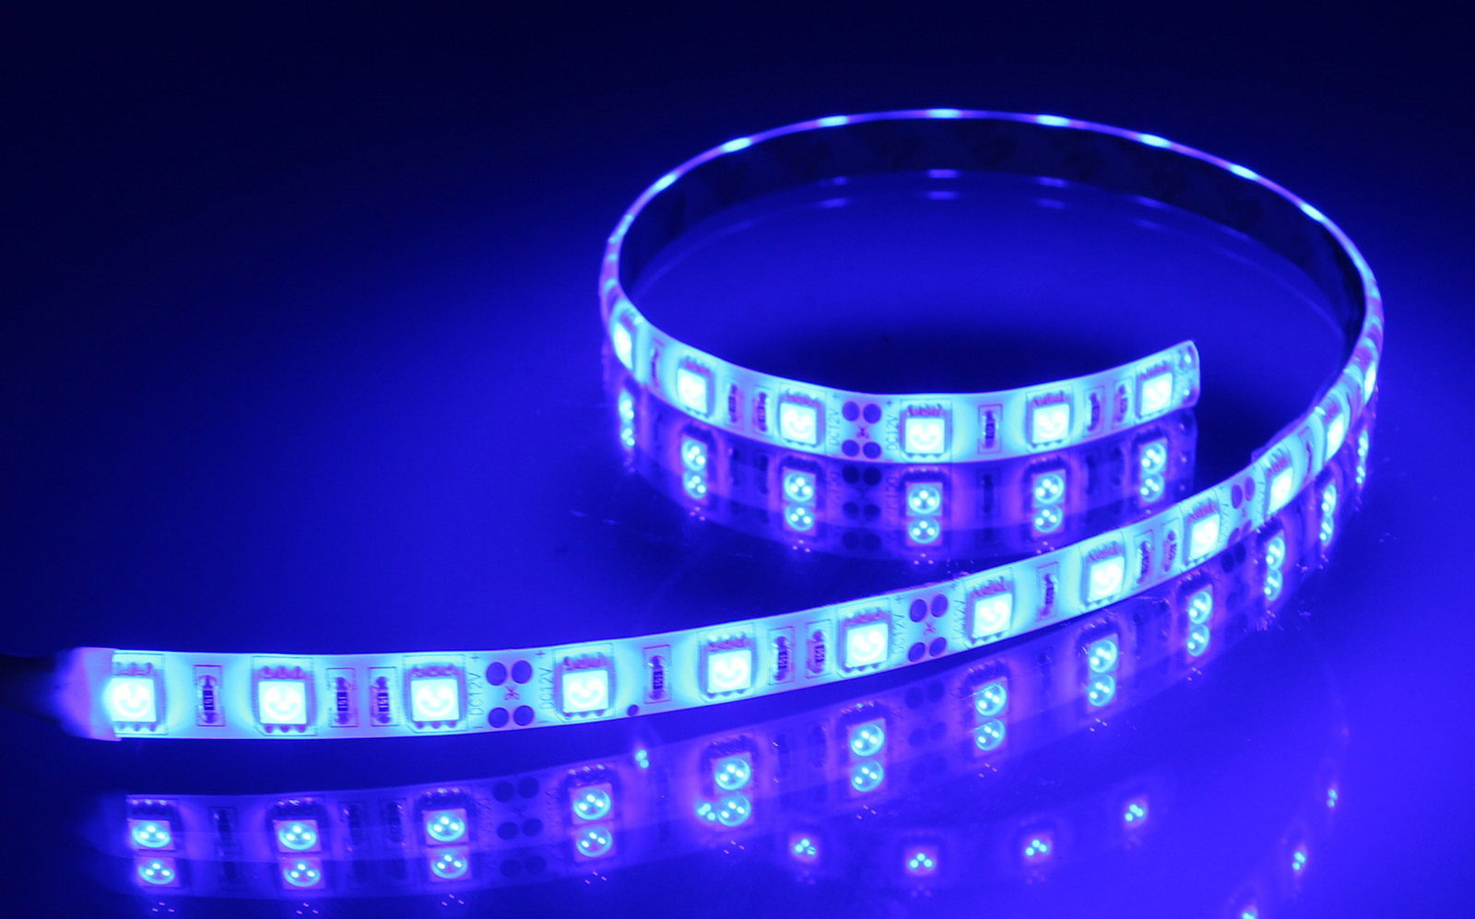
Speaker Verification
Lights Verification
Present a 1,000 Hz tone at 50 dB for one second
Turn on/off a string of LED lights five times at two second intervals
https://www.adafruit.com/product/1669
https://www.mightyape.co.nz/product/aurora-led-light-strip-blue/22166761
https://www.mightyape.co.nz/product/aurora-led-light-strip-blue/22166761

Slide 12
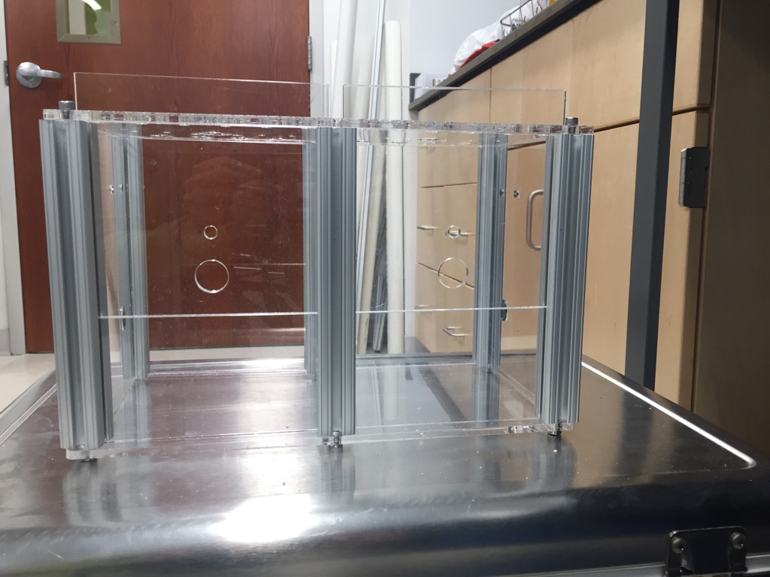
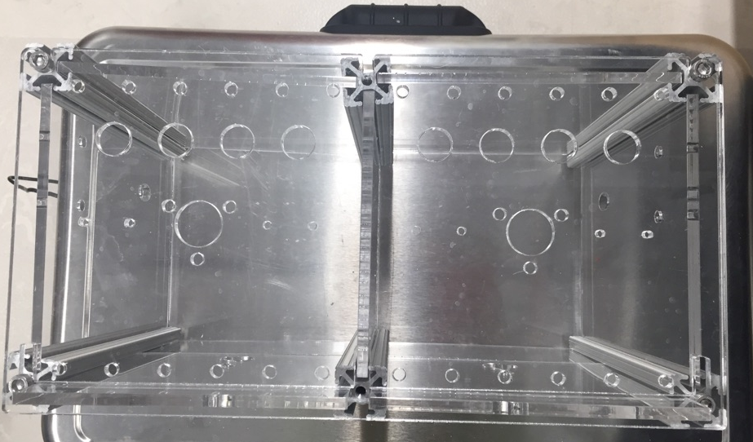
Cage Design Verification
COMPARE TO DIMENSIONS OF EXISTING CAGES
PLACE ON HENGEN LAB SHELVES
CONFIRM THE ANTECHAMBER IS INACCESSIBLE
observe mouse for 24 hours
Side-view (two normal cages)
Top-view (two normal cages)
RAT cage will have an antechamber
Notes:
compare the dimensions to existing cages
make sure the cage can fit on the Hengen lab shelves
observe a mouse in the cage for 24 hours to confirm the antechamber is anacessible

Slide 13
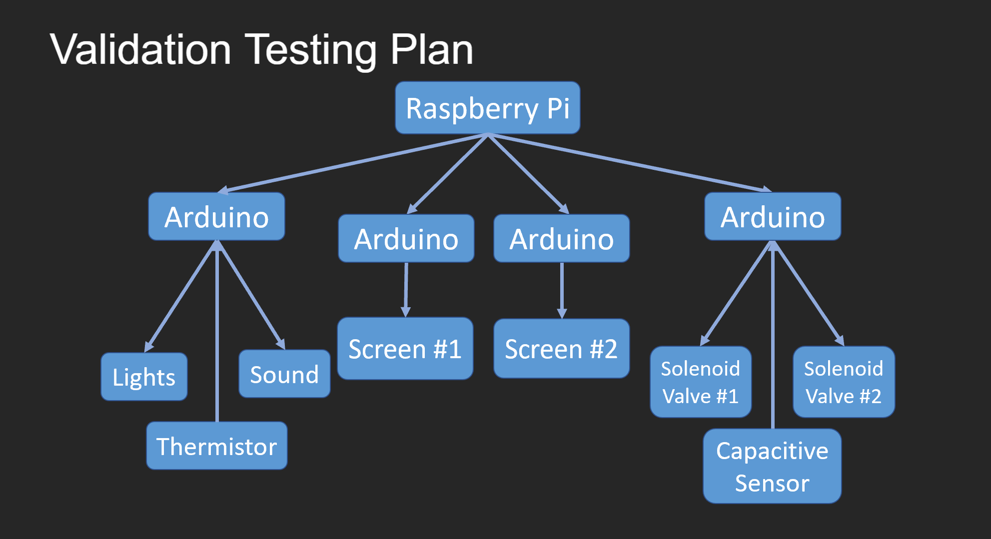
Validation Testing Plan
Notes:
our validation plan is constructed to make sure that all our hardware components work together
raspberry pi
four arduinos
screens
valves
capacitve sensor
lights and speaker
thermistor

Slide 14
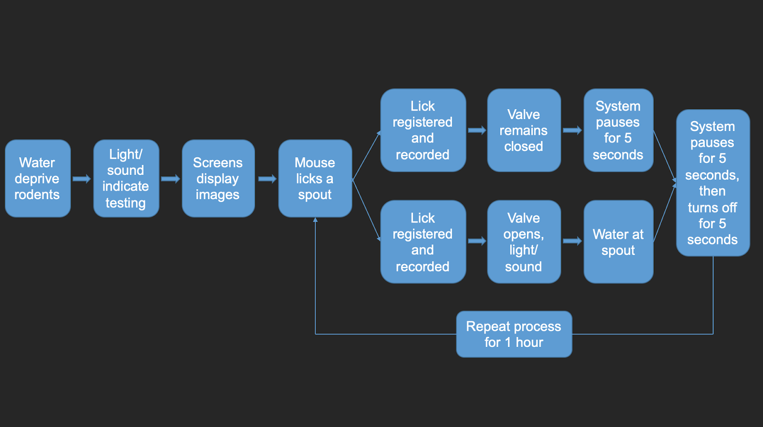
Rodent Training Protocol
Notes:
we will validate that the components work together by testing the training protocol
12 hours of water deprivation
Spouts do not deliver water when licked
At 9am (the beginning of training):
1,000 Hz tone plays for two seconds
String of LEDs lights up
Each screen lights up and displays an image

Slide 15
Rodent Training Protocol: Setup
Screens
Speaker
Water Reservoir
Goal-Post Head Fixation
Spout
Tubing
Wall Opening
Notes:
the physical setup for our training protocol
spouts are connected to capacitive sensors
each spout corresponds to the screen it is in front of
one screen and spout will be the "correct choice," and the other pair will be the incorrect choice

Slide 16
Rodent Training Protocol
Screens display pair of images
Rodent licks correct spout
Lick registered by Capacitive Sensor and recorded
Solenoid Valve opens, Light and Sound indicate correct choice
Wall Opening Screen Speaker
Water System Goal-Post Head Fixation
Rodent receives water reward at spout
Notes:
UPDATED
If the mouse licks the correct spout
Capacitive sensor registers lick
Signal sent to open solenoid valve
Water released at the spout
2,000 Hz tone played for 2 sec
LED strip lights up above screens
4. Screens remain on the images for 5 sec
5. Screens shut off for 5 sec
6. Cycle repeats with new images

Slide 17
Rodent Training Protocol
Screens display pair of images
Rodent licks incorrect spout
Solenoid Valve remains closed
System pauses for 5 seconds with screens still on as “timeout” punishment
Wall Opening Screen Speaker
Water System Goal-Post Head Fixation
Notes:
UPDATED
If the mouse licks the correct spout
Capacitive sensor registers lick
Signal sent to open solenoid valve
Water released at the spout
2,000 Hz tone played for 2 sec
LED strip lights up above screens
4. Screens remain on the images for 5 sec
5. Screens shut off for 5 sec
6. Cycle repeats with new images

Slide 18
FDA Approval Process
This cage is designed for rodent studies and therefore does not require FDA approval.
The Hengen lab has approval from the Institutional Animal Care and Use Committee (IACUC) to use this cage with mice.

Slide 19
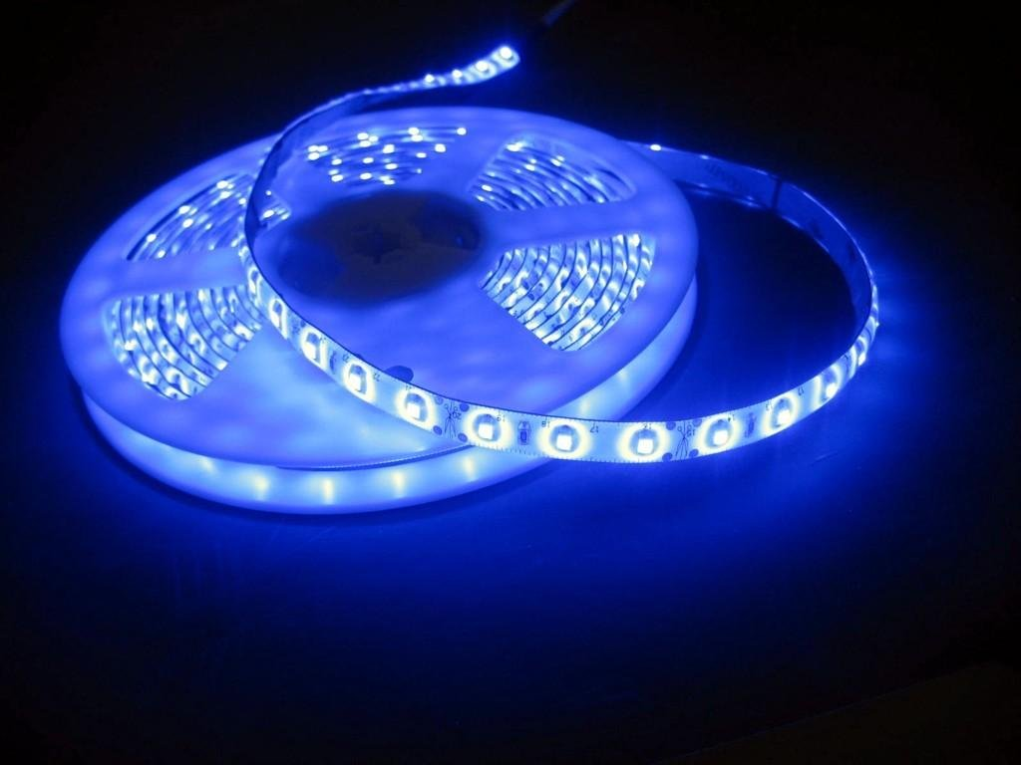
Status of Product:
Cage, Screens, Lights, Sound, Temperature, Humidity
Cage components have been laser cut
Walls, floor, ceiling, and antechamber
Components awaiting assembly
Screens controlled by Arduinos
One Arduino per screen
Light, sound, temperature/humidity
To-be assembled
https://www.mightyape.co.nz/product/aurora-led-light-strip-blue/22166761

Slide 20
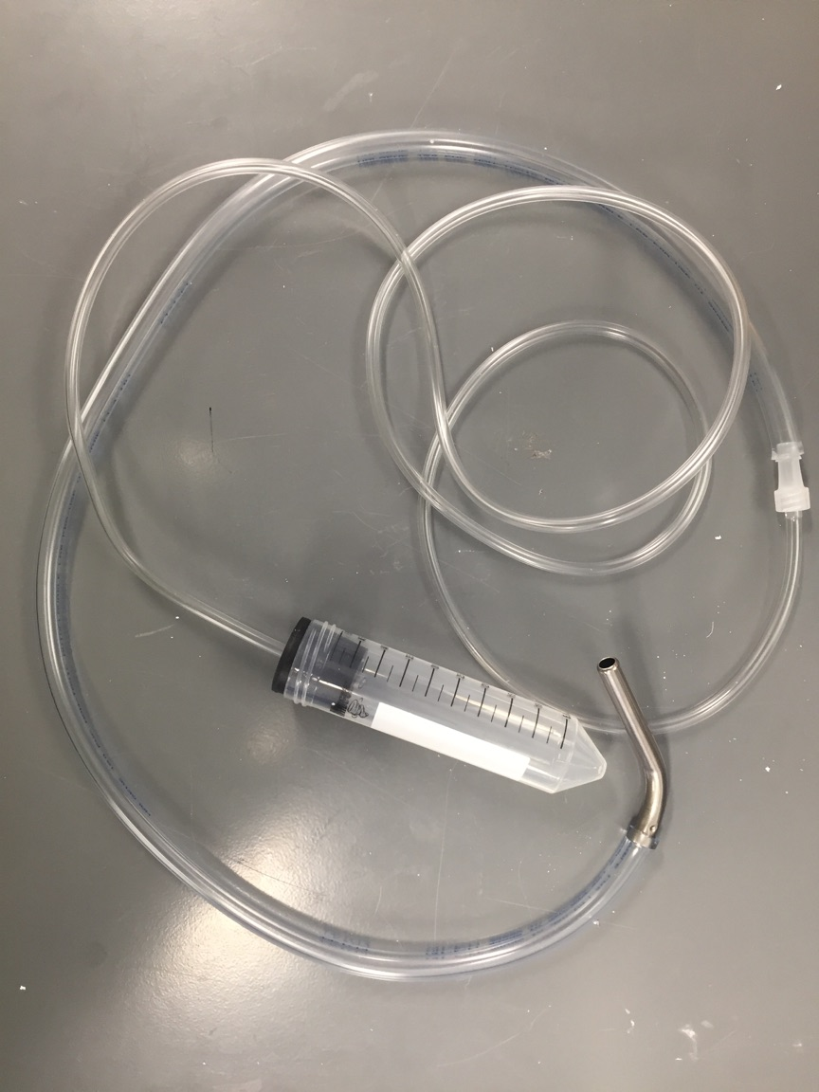
Status of Product: Water Delivery
Arduino Mega
Driving Motor
Water reservoir
Spout
Capacitive Touch Sensors
Solenoid Valve
Notes:
Arduino-controlled solenoid valve
Capacitive touch sensor in the same circuit
Reservoir, stopper, tubing, and spout connected

Slide 21
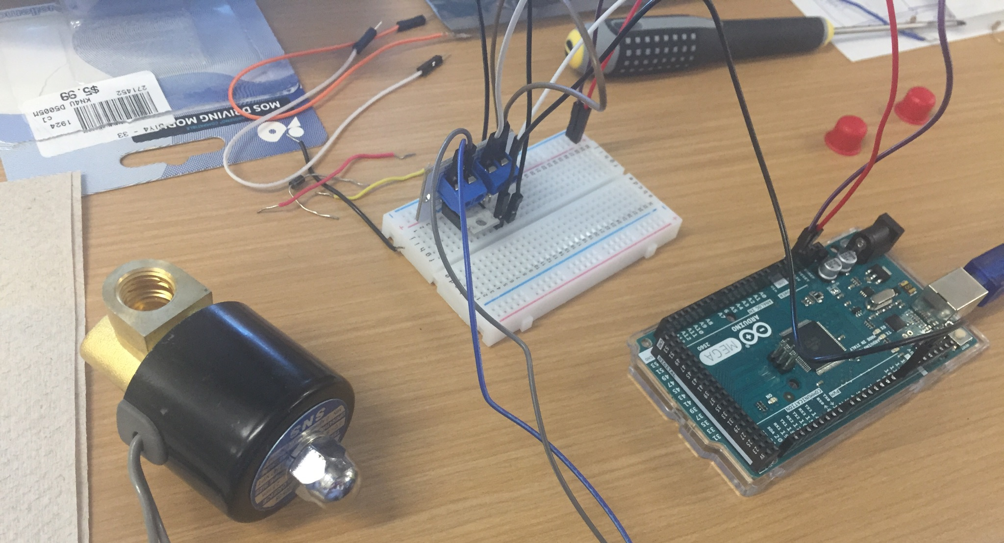
Proof of Concept: Water Delivery System
Testing of the solenoid valve
Driving Motor
Solenoid Valve
Arduino Mega
Notes:
UPDATED
Valve and driving motor circuit connected to an Arduino
Tube placed at the valve’s bottom opening
Water poured into the top opening
Code uploaded to the Arduino
Opened the valve for 2 sec, closed for 2 sec
Valve opening → movement of water to the bottom tube

Slide 22
Proof of Concept: Water Delivery System
Testing of the capacitive sensor
MPR121 sensor board connected to an Arduino
Code uploaded to the Arduino
Alert message printed upon touching any of the 12 sensors
Tap with finger
Notes:
demonstrating that the capacitive sensor could collect input at a specific location (touch) and then execute a command (print readout).

Slide 23
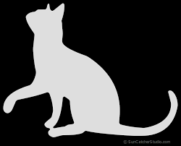
Proof of Concept: Screens
An arduino connected to each of two screens
Arduino code written to display a different image on each screen
Uploading Arduino code → screens displayed the images
https://suncatcherstudio.com/patterns/cat-silhouettes/
https://suncatcherstudio.com/patterns/cat-silhouettes/

Slide 24
Proof of Concept: Raspberry Pi Controlling Arduino
An existing Hengen lab setup demonstrates feasibility
Raspberry Pi signals to an Arduino
Arduino turns lights on/off
Time schedule based on circadian rhythm
https://www.raspberrypi.org/trademark-rules/
https://freebiesupply.com/logos/arduino-logo/
Notes:
to prove a raspberry pi can control an arduino, we looked to an existing setup in the Hengen lab
raspberry pi sets a time schedule for an arduino, which turns on and off lights based on the circadian rhythm of the rats

Slide 25
Thank you!

