Slide 1
Automated Rodent Training Apparatus
Ellie Degen, Sara McCutcheon, Zoe Orenstein
Notes:
Mention every single point on the rubric for all papers and presentations

Slide 2
Background/The Problem
Animal models are important for biomedical research¹
Predict drug effects
Develop treatments for disease
Hone in on cognitive and learning phenomena
Inform on decision making
Studies are difficult to reproduce^{1, 2}
Behavior can change with human/rodent interaction^{1, 2, 3}
Manual training is costly and time consuming^{1, 3, 4}
Market - researchers who conduct rodent studies
Environment - laboratory
Rivalan, Marion, et al. “An Automated, Experimenter-Free Method for the Standardised, Operant Cognitive Testing of Rats.” PLOS ONE, Public Library of Science, 6 Jan. 2017
Poddar, Rajesh, et al. “A Fully Automated High-Throughput Training System for Rodents.” PLOS ONE, Public Library of Science, 6 Dec. 2013,
Sorge RE, Martin LJ, Isbester KA, Sotocinal SG, Rosen S, Tuttle AH, et al. Olfactory exposure to males, including men, causes stress and related analgesia in rodents. Nat Methods. 2014 Jun; 11
Goltstein, Pieter M., et al. “Food and Water Restriction Lead to Differential Learning Behaviors in a Head-Fixed Two-Choice Visual Discrimination Task for Mice.” PLOS ONE, Public Library of Science, 13 Sept. 2018,

Slide 3
Client
Photo courtesy of the Hengen lab website

Slide 4
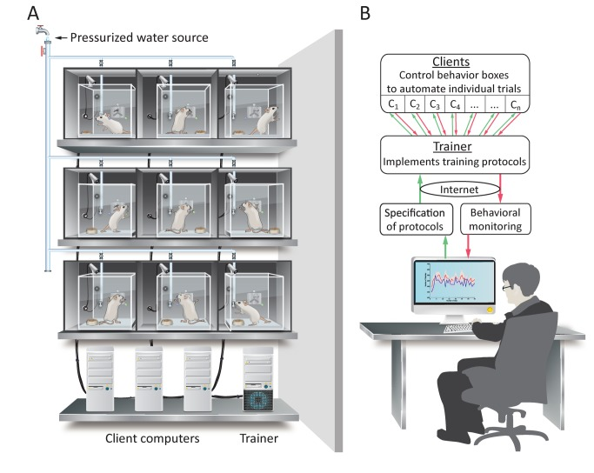
Need
Decrease time and manual labor of training
Incorporate specific environmental conditions
Poddar, R., Kawai, R., & Ölveczky, B. P. (2013). A Fully Automated High-Throughput Training System for Rodents. PLoS ONE, 8(12), e83171. http://doi.org/10.1371/journal.pone.0083171
Notes:
If you want to train a series of rats -
To decrease variability, you only have one researcher training each one
Issues: even more time consuming for study
Cannot concurrently have all the experiments at the same time

Slide 5
Scope
Design a cage that
Fits in the existing lab space
Automated food/water delivery
Environmental controls
All parameters will be programmable so they can be specific to the study
Notes:
Change this into bullet points

Slide 6
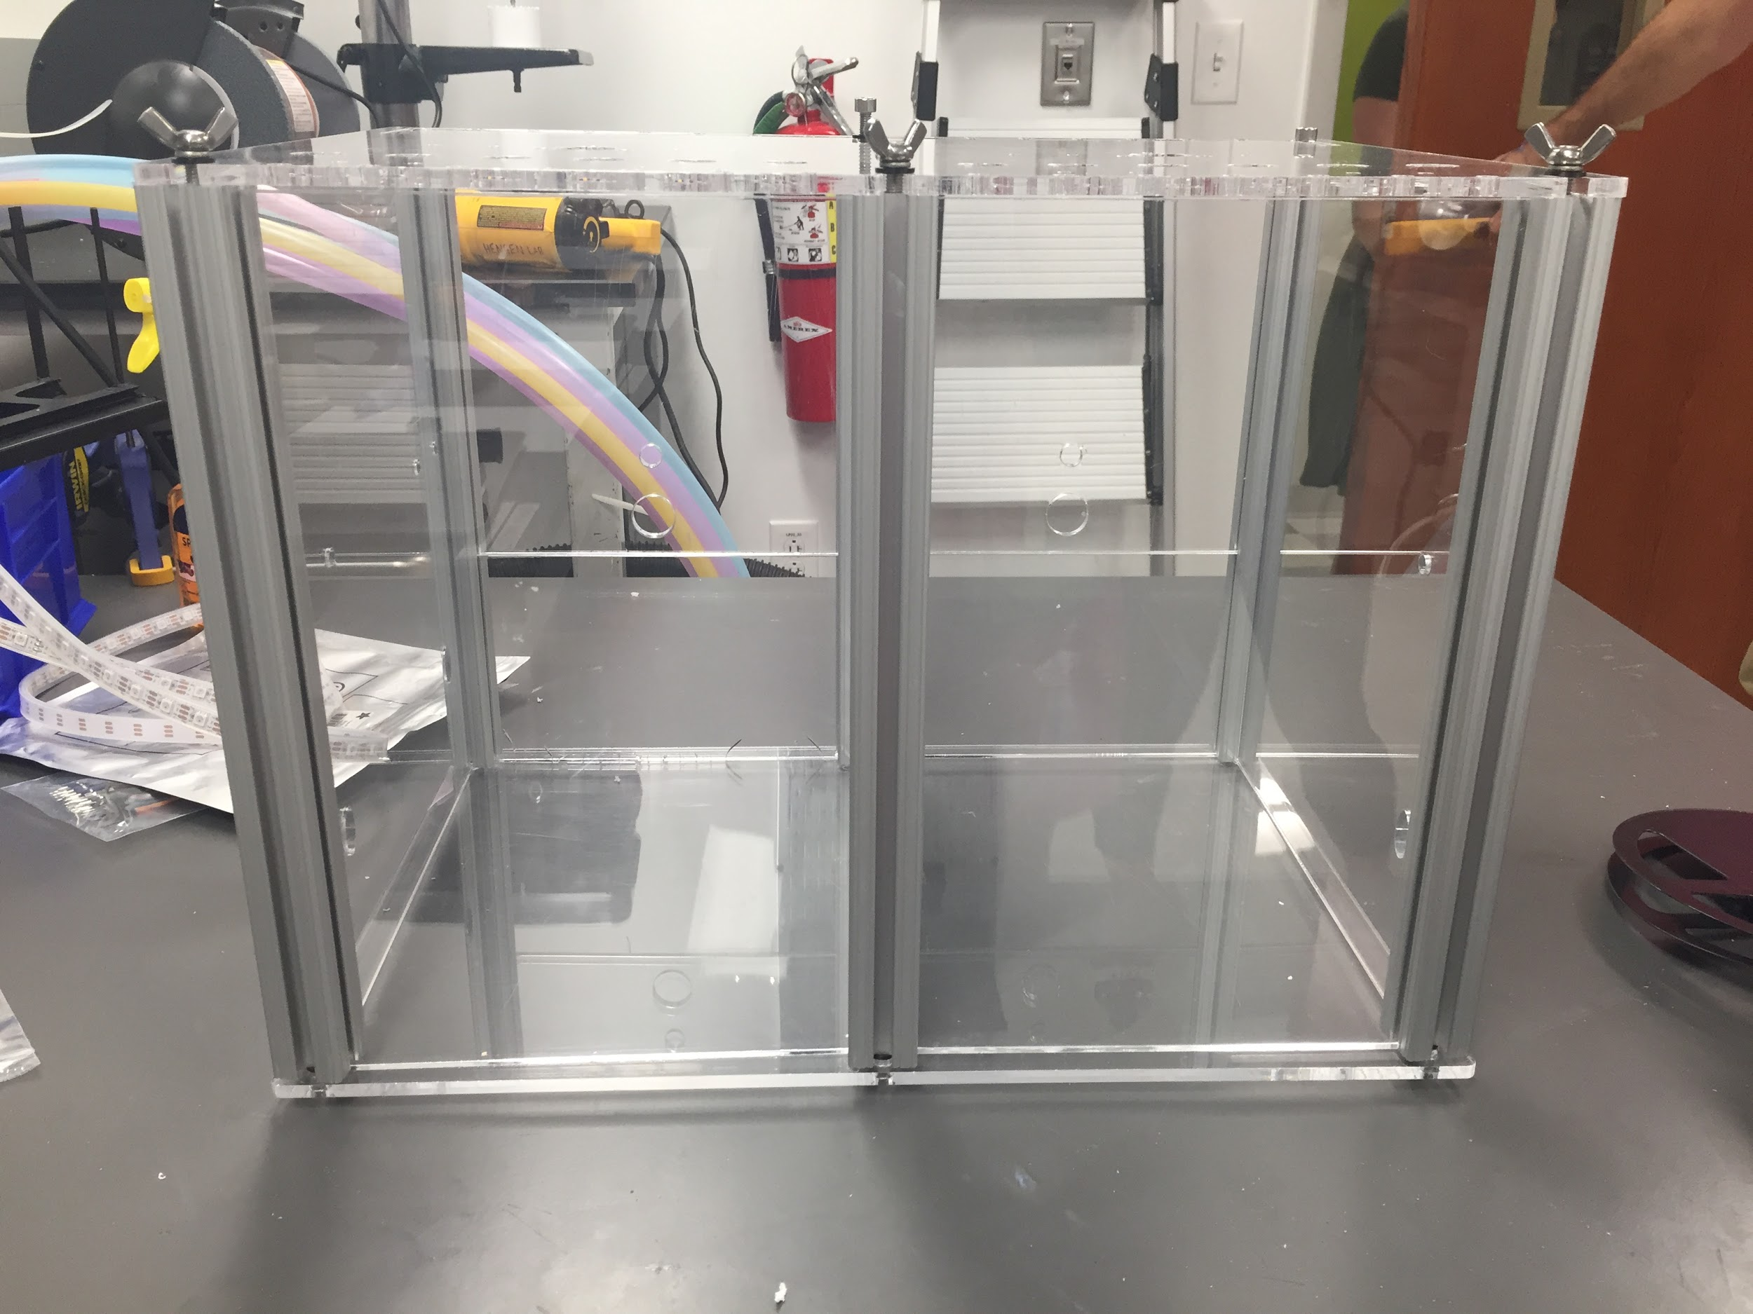
Design Specs - Cage
Design Component | Metric (inches, unless indicated otherwise)
Overall Cage Design | 7” x 14” x 12”
Support Beam (x6) | 1” x 1” x 12
Front Wall Base | 6” x 14”
Front Wall Sliding Top (x2) | 7” x 6”
Back Wall | 14” x 12”
Light Containment Cover | Outer Dimensions: 22.5” x 14.5” x 16”
 | Inner Dimensions: 20” x 12” x 13.5”
14”
12”
7”
Cage from the Hengen Lab. Photo courtesy of Ellie Degen

Slide 7
Design Specs - System Control
Water Port Opening | Radius: 0.25”
 | Location: 3.5” x 3” from front bottom left corner
Water Dispenser | Radius: 0.40”
 | Height: 4”
Food Dispenser | Triangular face: 3” x 4” x 5”
 | Length: 6.5”
Display Screen (x2) | 6” x 4” x .03”
Cage from the Hengen Lab. Photo courtesy of Ellie Degen
Notes:
Primary - food and water regulation

Slide 8
Design Specs - System Control
Temperature | 23°C
Beam Break Sensor (x2) | 0.8” x 0.4” x 0.3”
Capacitor Sensor (x2) | 4.4” x 0.25” x 0.2”
Temperature/Humidity Sensor | 1.05” x 2.32” x 0.53
Arduino Uno (x5) | 2.1” x 2.8” x 0.5”
LED Strip | 19.7” x 0.6” x 0.2”
Cage from the Hengen Lab. Photo courtesy of Ellie Degen

Slide 9
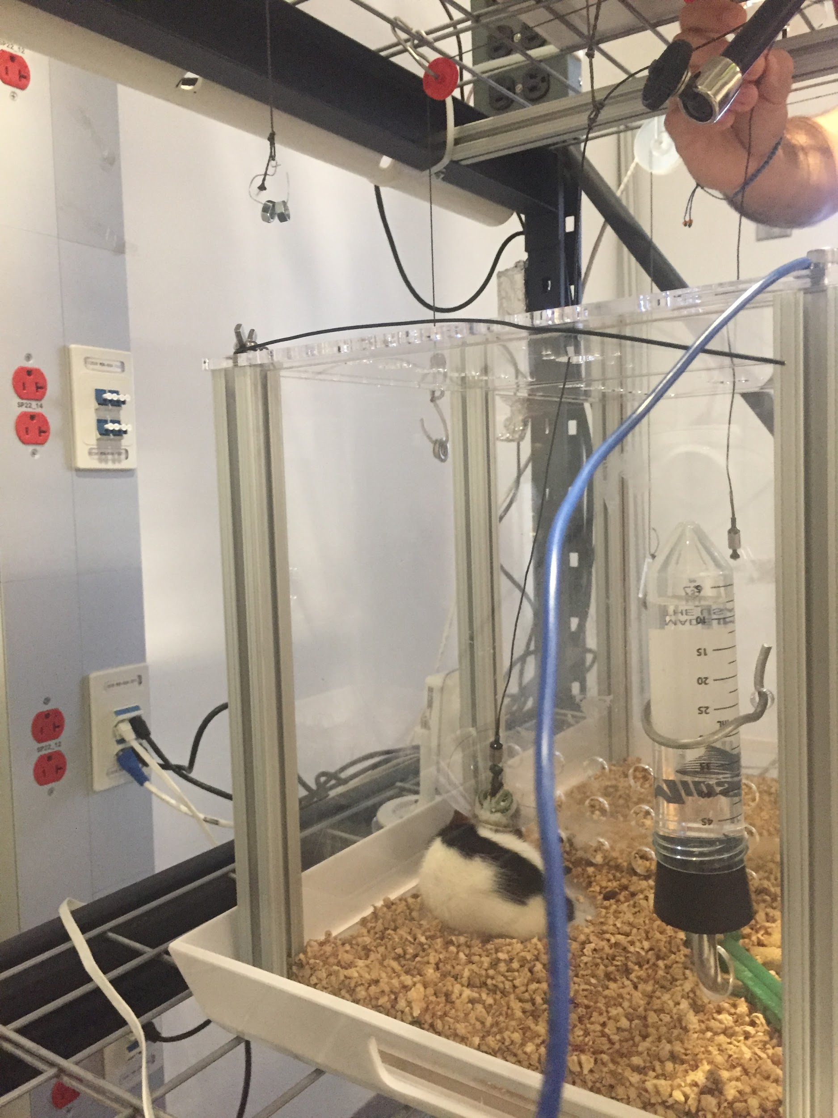
Existing Solutions: Traditional Methods
Manual training¹
Time and labor-intensive
Feeding
Moving rat from home to training area
Introduction and removal of stimuli
Unnatural conditions
Head fixation
Lever pushing
Human contact
Photo of home cage used in the Hengen Lab. Photo courtesy of Ellie Degen
Goltstein, Pieter M., et al. “Food and Water Restriction Lead to Differential Learning Behaviors in a Head-Fixed Two-Choice Visual Discrimination Task for Mice.” PLOS ONE, Public Library of Science, 13 Sept. 2018,
Notes:
Picture - this is a picture of a traditional home cage used in the hengen lab

Slide 10
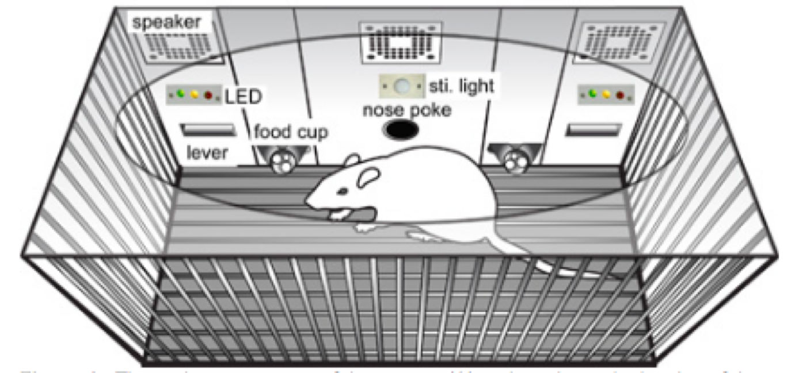
Existing Solutions: Automated Training in Research
Automated auditory training to redeem a food reward¹
Diagram of Cage used in Zheng lab (1)
Zheng, W., Ycu, E. A. (2012). A Fully Automated and Highly Versatile System for Testing Multi-cognitive Functions and Recording Neuronal Activities in Rodents. J. Vis. Exp. (63), e3685, http://doi.org/:10.3791/3685.
Notes:
Issues: lever pushing - not natural for rats and therefore takes longer for them to learn how to do. Made specifically for the Zheng lab - assumed soundproof area already so that the only sounds that entered the cage were the training sounds. Not true for Hengen Lab. Additionally, this design is specific to their software setup, making it difficult to integrate into other labs that have their own systems. Designed with food deprivation in mind - Hengen Lab protocols either use water deprivation or drug delivery.
San Diego

Slide 11
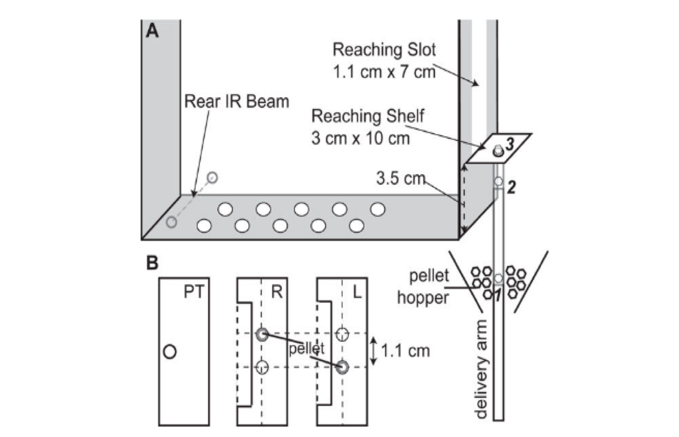
Existing Solutions: Automated Training in Research
Automated pellet reaching system and video capture¹
Diagram of Cage used in Ellens lab (1)
Ellens, D. J., Gaidica, M., Toader, A., Peng, S., Shue, S., John, T., Leventhal, D. K. (2016). An automated rat single pellet reaching system with high-speed video capture. Journal of Neuroscience Methods, 271, 119–127. http://doi.org/10.1016/j.jneumeth.2016.07.009
Notes:
Has soundproof chamber and ventilation system. Additionally has automated food. All these components are in the same software
All good
We are not testing pellet reaching (biomechanics project). Main issue - biomechanics research - not what we are testing. Also does not have automatic water regulation, which is a large part of the Hengen protocols.

Slide 12
Failure to Address the Hengen Lab’s Need:
Existing automated training systems are too individualized to experiments performed in other labs.
Notes:
Overarching issue - too individualized

Slide 13
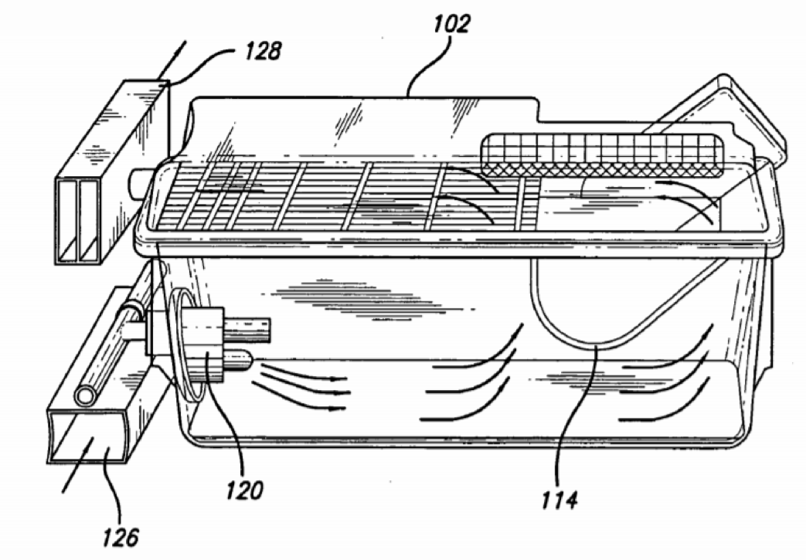
Existing Solutions: Patented
Two categories of automated cages:
Environment regulating
Monitoring wall with sensors¹
Regulation of
Temperature
Oxygen, nitrogen, carbon dioxide concentrations
Training
Rodent moved to automated training arena²
Maze with an electronically programmable floor
Cage designed by Ingley, Hahn, and Battles
Ingley, H. A., III, Hahn, D. W., & Battles, A. H. (2005). U.S. Patent No. US2005O241591A1. Washington, DC: U.S. Patent and Trademark Office.
Gondhalekar, V., & Brunner, D. (2003). U.S. Patent No. US20030024482A1. Washington, DC: U.S. Patent and Trademark Office.

Slide 14
Failure to Address the Hegen Lab’s Need:
Marketed solutions do not include simultaneous automation of the cage environment and training stimuli.

Slide 15
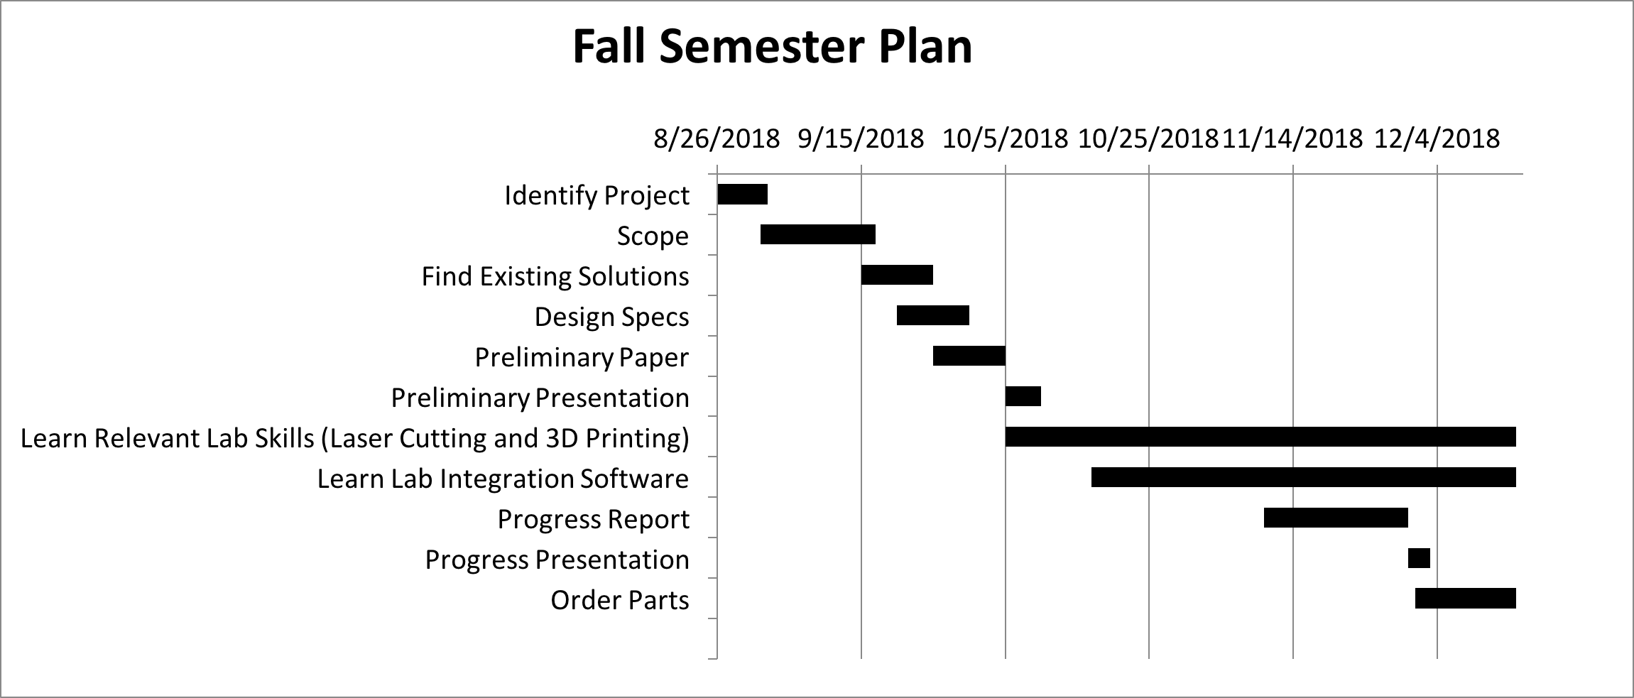
Design Schedule - Fall
Notes:
Big hits - Learning relevant skills: Laser cutting, 3D printing, software the lab already uses so that we can integrate our programs without difficulty. Finding and ordering parts at the end of the semester

Slide 16
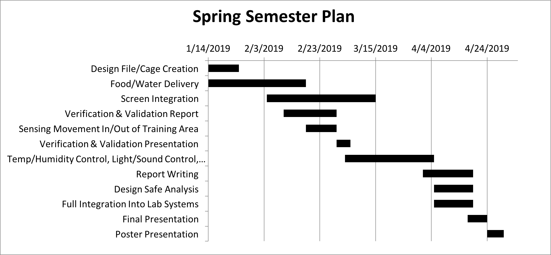
Design Schedule - Spring
Notes:
Big hits: Cage creation, food and water delivery, screen, beam break, environment control, drug delivery (but secondary)
Lots of time for food and water (most important, also first project)
Lots of time for screen because we want to give ourselves time to learn about how screens are used now and how to integrate the training
Beam break - important but should not take too long, there is a ton of source code already out there and the physical construction is not difficult
Environment control - giving a long time for all of them, but we will be working on all of them at the same time. None of them are too difficult.
Drug delivery is not a primary goal, but our client would like us to look into it and see if it is viable. The main goals are priority
Because of the modular way our project is set up, we are going to be integrating each element as they are completed. Additionally, we will be writing user instructions as we complete each portion

Slide 17
Team Organization
Ellie
Finding/ordering parts
Food/Water
Screen
Light
Sound
Sara
CAD Modeling
Screen
Light
Sound
Zoe
Client Communication
Food/water
Beam Break (Sensing)
Temperature
Humidity
Notes:
Together:
Research, cage construction, integrating into lab, writing reports and instructions

Slide 18
Questions?

